Slide 1


Available on GitHub
Made with ❤️ by Martí Climent
ElevenClock
Freedom for your Windows 11 Clock
100% Free, Forever
And it is Open-Source!

Slide 2
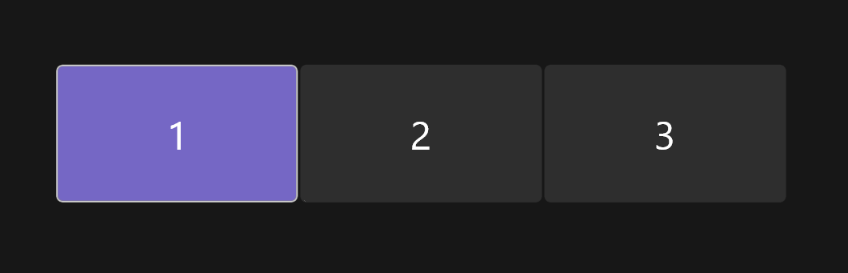
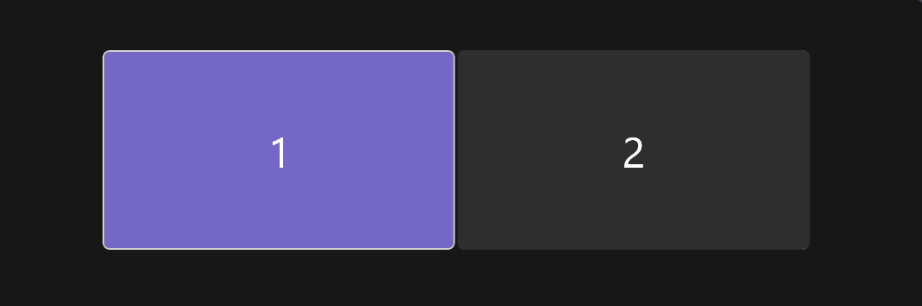
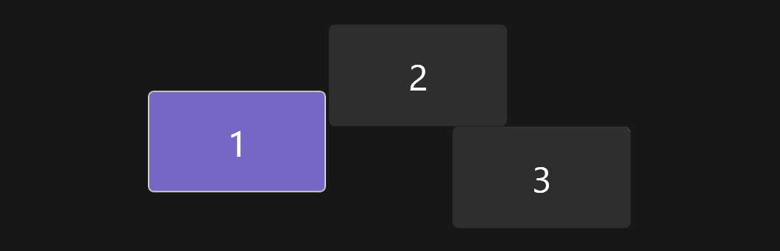



More than one monitor!
ElevenClock supports any screen arrangement you can think of!
2, 3, 4 displays... People with 10 displays have reported ElevenClock to work flawlessly

Slide 3
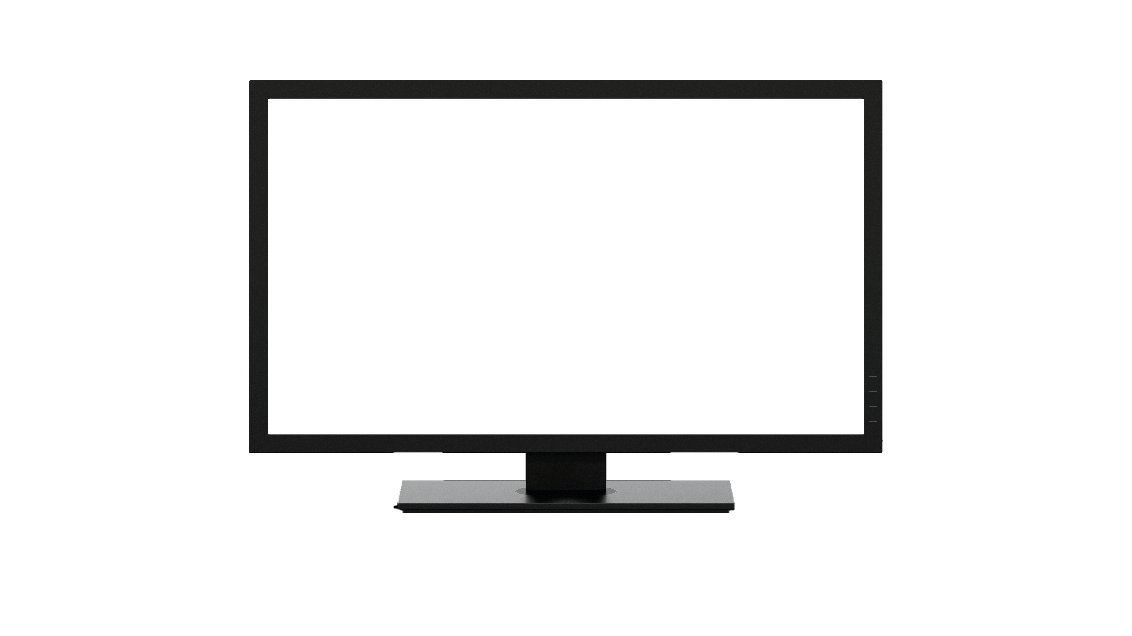
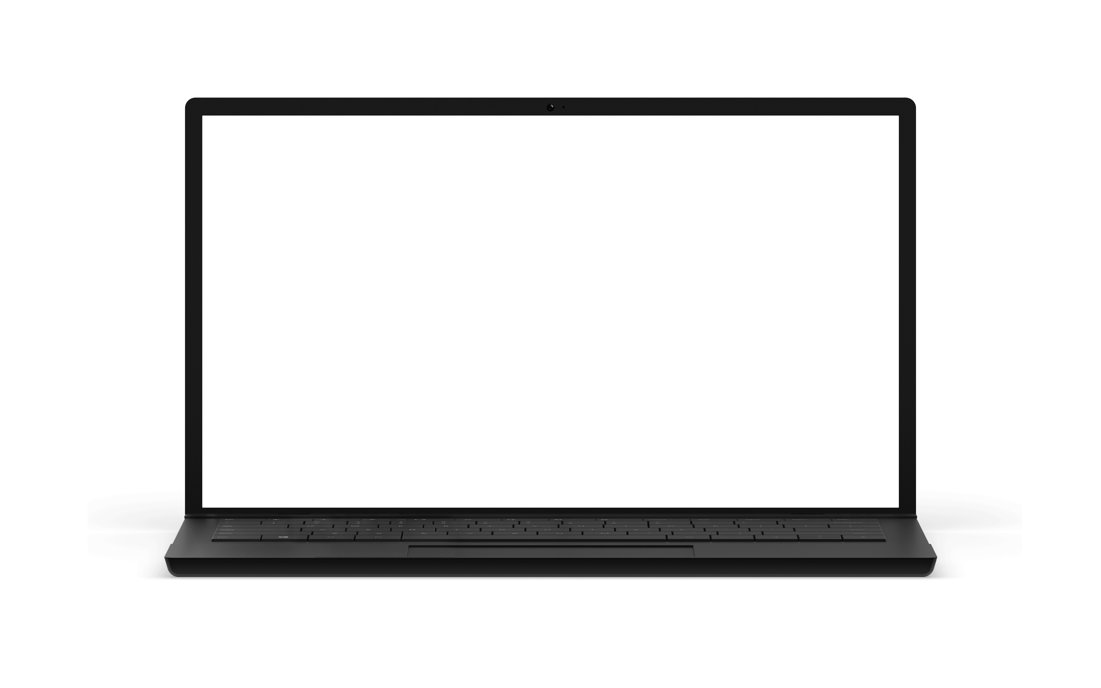
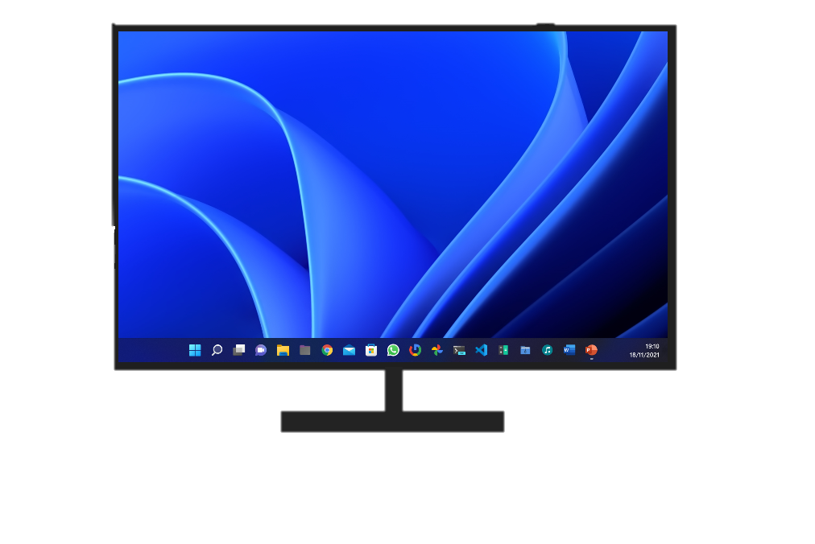
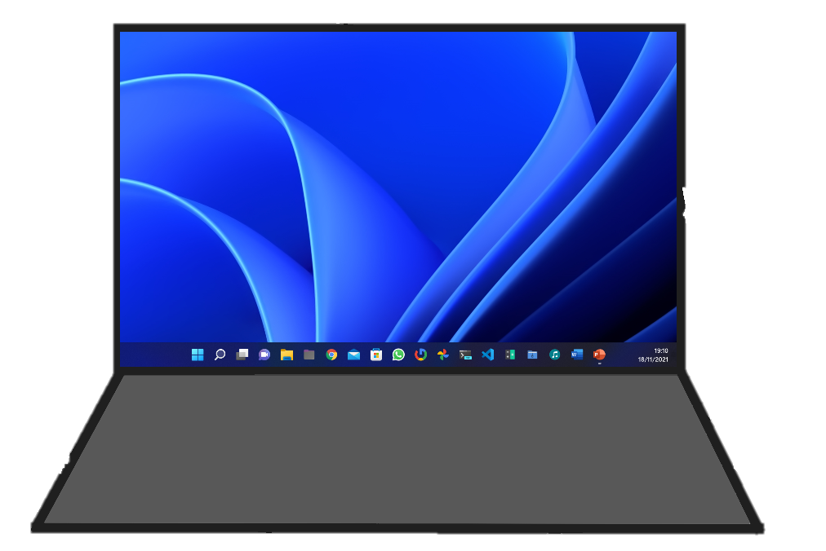
It even works on-the-go!
ElevenClock will show in new displays when you connect them!
But if you prefer, ElevenClock can be disabled on a per-app basis

Slide 4
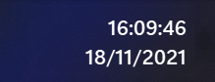



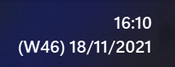

Seconds, you said?
Add Seconds: |  | Show only the date:
Add Weekday: |  | Show only the time:
Add Week number: |  | Your custom choice:
Set any date and time format, and ElevenClock will show it for you.

Slide 5
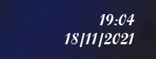
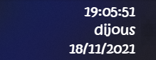
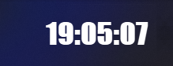
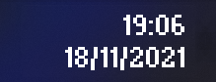
Change the font...
Alternative font: |  | Hand-drawn clock:
Impacting time: |  | For the MS-DOS fans:

Slide 6
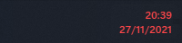
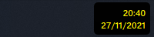

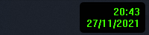
...and whole the color scheme!
Red mode: |  | Nuclear clock:
Sea mode: |  | Retro clock:
You can customize ElevenClock’s look and feel to make it yours, only you set the límits!

Slide 7
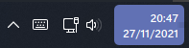
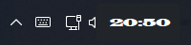
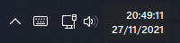
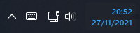
Replace your System Clock!
Accent color: |  | Wide clock:
Add seconds: |  | Blue clock:
Because why not!

Slide 8
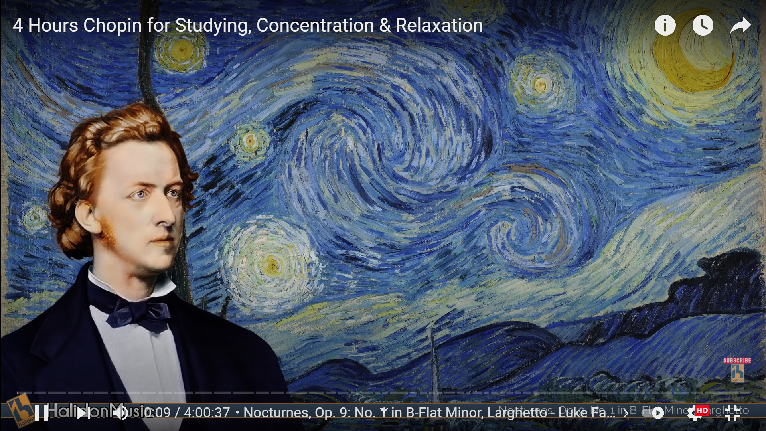

Automatically hide. Or not
ElevenClock can be set to hide with fullscreen Windows But it can also be set to show over them!

Slide 9
Move the clock around
ElevenClock displays on the right corner of your screen by default. (because that’s what Windows does)
But it can be moved to the left side with less than two clicks
Additionally, move each clock to the top and/or to the left on a per-monitor choice, and
have FLOATING CLOCKS everywhere!

